Slide 1



DYNAMAP Project:
Procedure for Noise Mapping Updating in Urban Area
G. Zambon, A. Bisceglie, R. Benocci, M. Smiraglia, H.E. Roman
Dipartimento di Scienze dell’Ambiente e del Territorio e di Scienze della Terra,
Università di Milano-Bicocca, Piazza della Scienza 1, 20126 Milano, Italy
INTER-NOISE 2017
46TH INTERNATIONAL CONGRESS AND EXPOSITION
ON NOISE CONTROL ENGINEERING
HONG KONG
27 - 30 AUGUST, 2017

Slide 2

CONTENT:
What is DYNAMAP
Where it is implemented
Basic Idea: Interpolation
Non-Acoustic Parameter
Pilot Area of DYNAMAP
The Six Groups: Noise Maps
Initialization - Updating of DYNAMAP
7.1 Treatement of Noise Signal and Leq variations from each Station
7.2 Starting Operation of Dynamap from 4 stations in each group
7.3 The group acceptance interval: Elimination of anomalous events
  7.4 Operation using the Clustering of the 24 recording stations
  7.5 Leq at time t for arbitrary receiver point a.
  8. CONCLUSIONS.

Slide 3
DYNAMAP: Goals
Generate Real-Time
Dynamic Traffic Noise Maps
within a Large Urban Area
using few Monitoring Noise Stations.
Each Noise Map represents a group of road stretches,
displaying similar Acoustic Equivalent Levels, Leq.

Slide 4
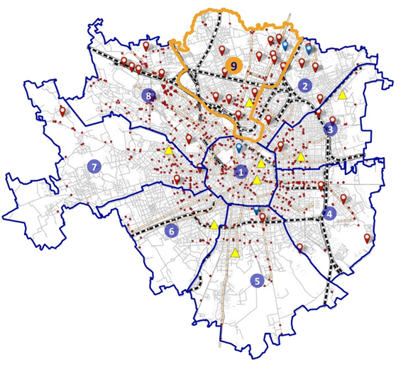
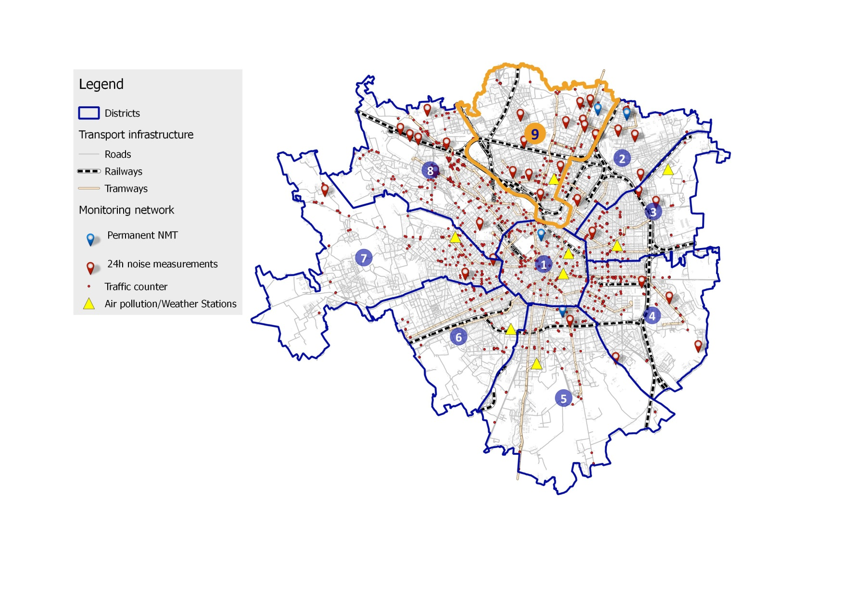
2. The Nine Urban Areas of Milan City
Urban Zone 9
(Pilot Area)

Slide 5
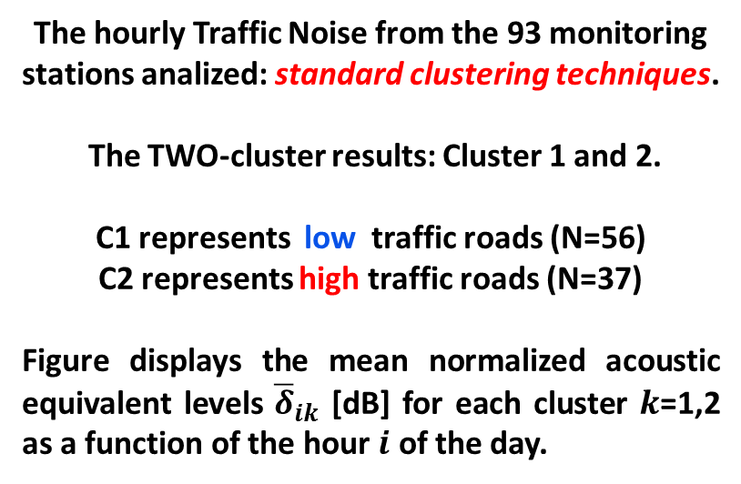
3. Modeling Noise in a Large Urban Area:
Basic Observations on Data of 93 noise stations
The hourly Traffic Noise from the 93 monitoring stations analized: standard clustering techniques.
The TWO-cluster results: Cluster 1 and 2.
C1 represents low traffic roads (N=56)
C2 represents high traffic roads (N=37)
Figure displays the mean normalized acoustic equivalent levels ${\overline{δ}}_{ik}$ [dB] for each cluster $k$=1,2 as a function of the hour $i$ of the day.
The Idea is to interpolate between behaviors of C1 and C2 for arbitrary road.

Slide 6
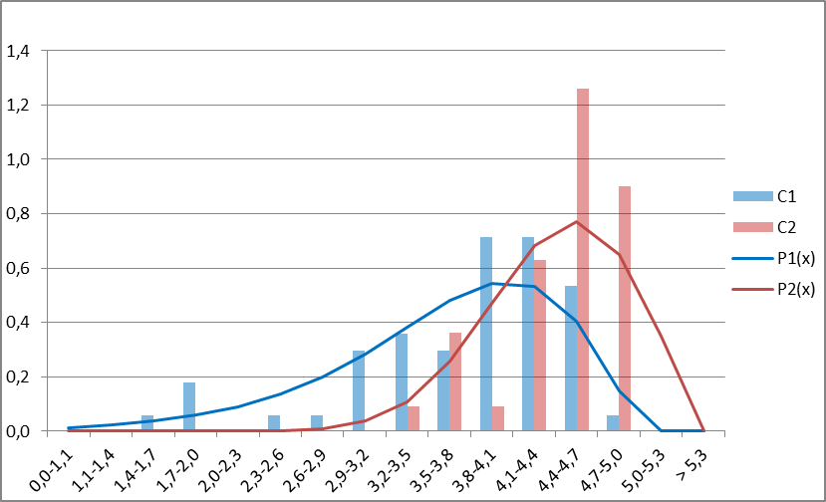
Interpolation scheme:
The non-acoustic parameter x.
P(x)
  T_{T} = Total daily traffic flow rate
  The non-acoustic parameter x = Log(T_{T})
  The distribution functions P₁(x) and P₂(x)
  of x on each cluster.
  The probability that x belongs to Cluster 1
  β₁(x) = P₁(x) / (P₁(x)+ P₂(x))
  and to Cluster 2
  β₂(x) = P₂(x) / (P₁(x)+ P₂(x))
x
Distribution functions P₁(x) and P₂(x) of x = log(T_{T}) on Noise Clusters 1 and 2, respectively. (N=93)
The continuous lines represent logarithmic fits to the
actual histograms using the cumulative distribution
functions, used to determine β_{1,2} accurately.

Slide 7
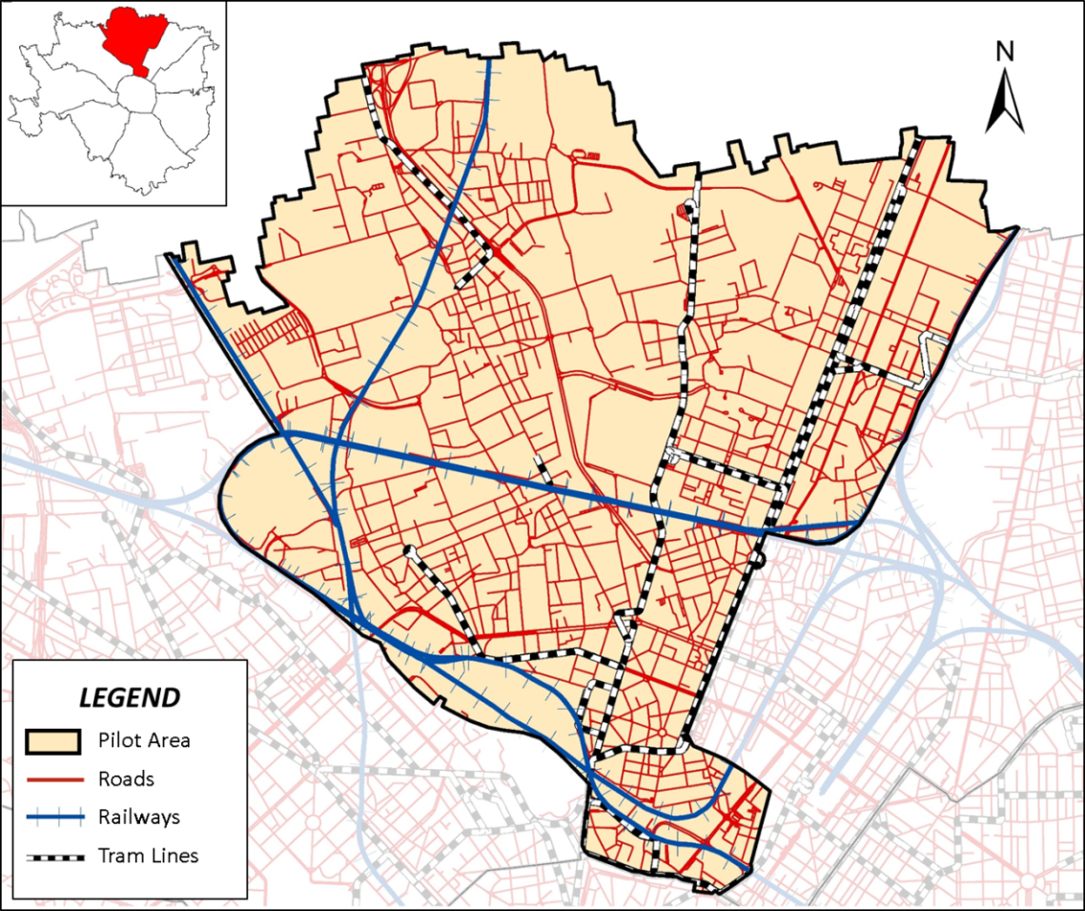
5. DYNAMAP Pilot Area: The Urban Zone 9 of Milan City
Monitoring Traffic Noise by
means of 24 Noise Stations
Noise Stations
Is divided into SIX Groups
According to Non-Acoustic
Parameter X.
FOUR stations per Group.

Slide 8
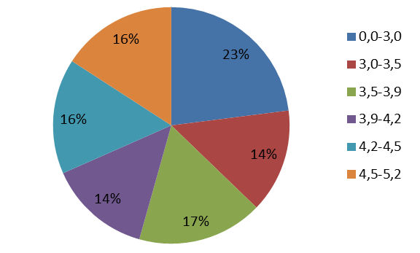
6. The Six Groups (Acoustic Maps, X = log(T_{T}))
- Zone 9 of Milan City -
X
X 0.0 – 3.3 3.3 – 3.5 3.5 – 3.9 3.9 – 4.2 4.2 – 4.5 4.5 – 5.2
β1 0.99 0.81 0.63 0.50 0.41 0.16
β2 0.01 0.19 0.37 0.50 0.59 0.84
Mean values of β1 and β2 for each group g.

Slide 9
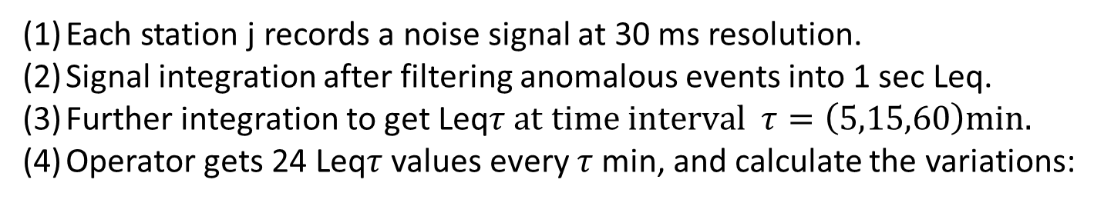
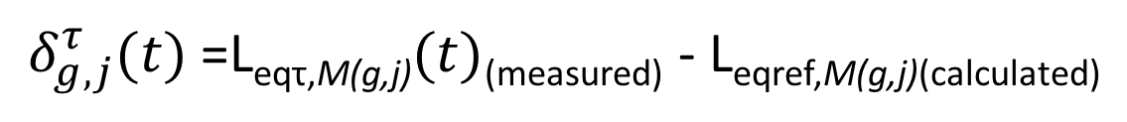
7. Initialization-Updating of DYNAMAP
7.1 Treatement of Noise Signal and Leq variations from each Station
Each station j records a noise signal at 30 ms resolution.
Signal integration after filtering anomalous events into 1 sec Leq.
Further integration to get Leq$τ at time interval τ=\left(5,15,60\right)min.$
Operator gets 24 Leq$τ$ values every $τ$min, and calculate the variations:
$δ_{g,j}^{τ}(t)$=L_{eqτ,M(g,j)}$(t)$_{(measured)} - L_{eqref,M(g,j)(calculated)}
(1)
( j=1,2,3,4 is station index j inside group g ). The time intervals are distributed according to:
τ = 5 min in (7:00-21:00), τ = 15 min in (21:00-1:00), τ = 60 min in (1:00-7:00)

Slide 10

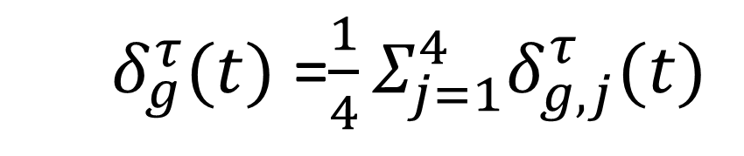
7. Initialization-Updating of DYNAMAP
7.2 Starting Operation of Dynamap from 4 stations in each group: $δ_{g,j}^{τ}(t)$
Once all the${ δ}_{g,j}^{τ}\left(t\right)$ values are obtained, the six acoustic maps
can be updated corresponding to each group $g$by averaging the
variations in Eq. (1) over the four values j in each group, as
$δ_{g}^{τ}(t)$ =$\frac{1}{4}Σ_{j=1}^{4}δ_{g,j}^{τ}(t)$
(2)
$For each group g$=(1,2,3,4,5,6) and time interval $τ=\left(5,15,60\right)min$.

Slide 11
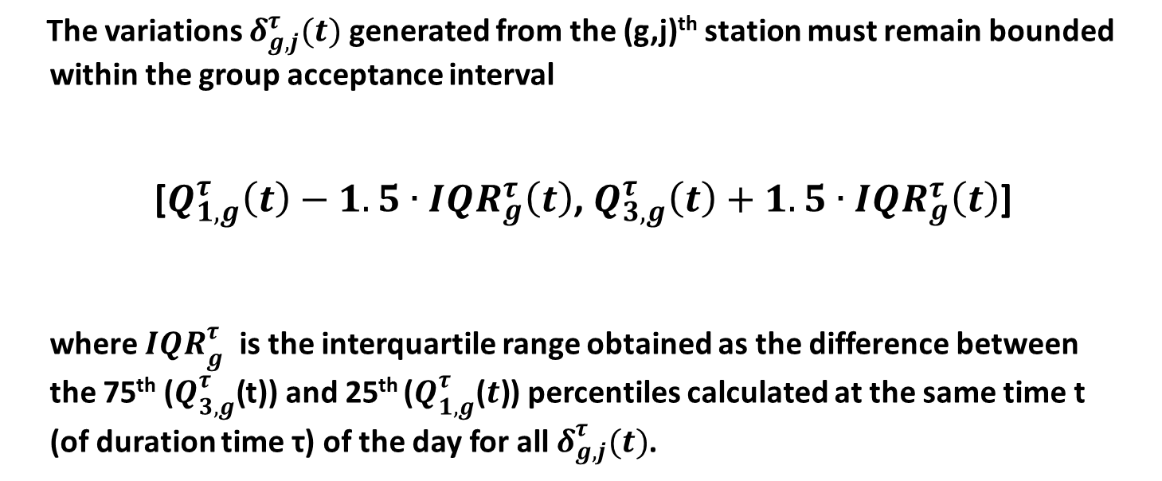
7. Initialization-Updating of DYNAMAP
7.3 The group acceptance interval: Elimination of anomalous events
The variations $δ_{g,j}^{τ}(t)$ generated from the (g,j)^{th} station must remain bounded
within the group acceptance interval
[$Q_{1,g}^{τ}\left(t\right)−1.5∙{IQR}_{g}^{τ}\left(t\right)$, $Q_{3,g}^{τ}\left(t\right)+1.5∙{IQR}_{g}^{τ}\left(t\right)$]
where ${IQR}_{g}^{τ}$ is the interquartile range obtained as the difference between
the 75th ($Q_{3,g}^{τ}\text{(}$t)) and 25th ($Q_{1,g}^{τ}\text{(}t\text{)}$) percentiles calculated at the same time t
(of duration time τ) of the day for all $δ_{g,j}^{τ}(t)$.

Slide 12
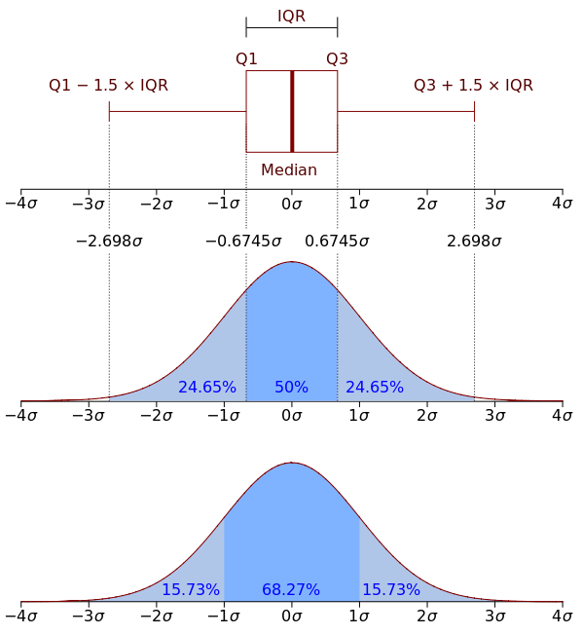
Boxplot and a probability density function (PDF)
of a Normal N(0,σ) distribution.

Slide 13
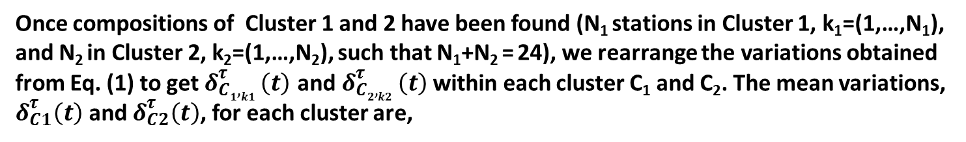
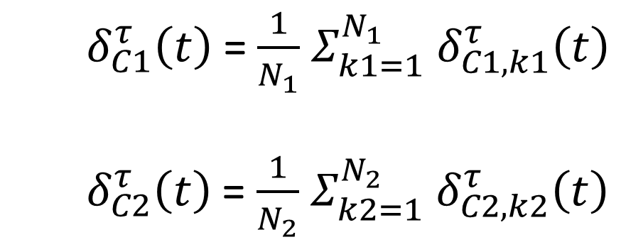
7. Initialization-Updating of DYNAMAP
  7.4 Operation using the Clustering of the 24 recording stations:$δ_{C1,2}^{τ}\left(t\right)$
Once compositions of Cluster 1 and 2 have been found (N₁ stations in Cluster 1, k₁=(1,…,N₁), and N₂ in Cluster 2, k₂=(1,…,N₂), such that N₁+N₂ = 24), we rearrange the variations obtained from Eq. (1) to get $δ_{C1,k1 }^{τ}\left(t\right)$ and $δ_{C2,k2 }^{τ}\left(t\right)$ within each cluster C₁ and C₂. The mean variations, $δ_{C1}^{τ}\left(t\right)$ and $δ_{C2}^{τ}\left(t\right)$, for each cluster are,
$δ_{C1}^{τ}\left(t\right)$ = $\frac{1}{N_{1}}$ $Σ_{k1=1}^{N_{1}} δ_{C1,k1}^{τ}\left(t\right)$
${ δ}_{C2}^{τ}\left(t\right)$ = $\frac{1}{N_{2}}$ $Σ_{k2=1}^{N_{2}} δ_{C2,k2}^{τ}\left(t\right)$

Slide 14
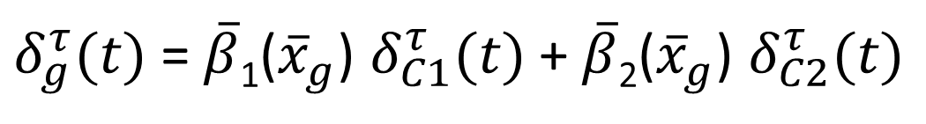
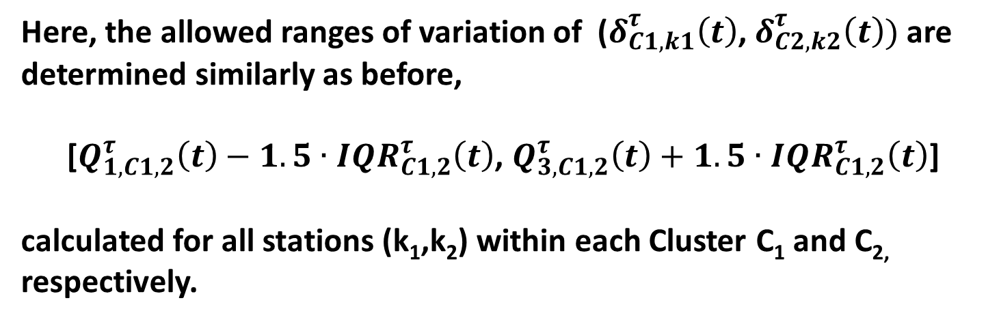
7. Initialization-Updating of DYNAMAP
Here, the allowed ranges of variation of ($δ_{C1,k1}^{τ}\left(t\right)$,${ δ}_{C2,k2}^{τ}\left(t\right))$ are determined similarly as before,
[$Q_{1,C1,2}^{τ}\left(t\right)−1.5∙{IQR}_{C1,2}^{τ}\left(t\right)$, $Q_{3,C1,2}^{τ}\left(t\right)+1.5∙{IQR}_{C1,2}^{τ}\left(t\right)$]
calculated for all stations (k₁,k₂) within each Cluster C₁ and C_{2,} respectively.
The mean variation $δ_{g}^{τ}(t)$ associated to each group g is,
$δ_{g}^{τ}(t)$ =$\overline{β}$₁(${\overline{x}}_{g}$) $δ_{C1}^{τ}(t)$ + $\overline{β}$₂(${\overline{x}}_{g}$) $δ_{C2}^{τ}(t)$
(3)

Slide 15
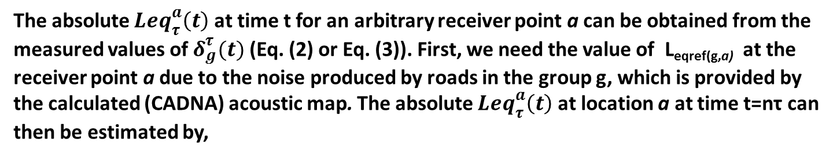
7. Initialization-Updating of DYNAMAP
  7.5 Leq at time t for arbitrary receiver point a:${Leq}_{τ}^{a}\left(t\right)$
The absolute ${Leq}_{τ}^{a}\left(t\right)$ at time t for an arbitrary receiver point a can be obtained from the measured values of $δ_{g}^{τ}(t)$ (Eq. (2) or Eq. (3)). First, we need the value of L_{eqref(g,a)} at the
receiver point a due to the noise produced by roads in the group g, which is provided by
the calculated (CADNA) acoustic map. The absolute ${Leq}_{τ}^{a}\left(t\right)$ at location a at time t=nτ can
then be estimated by,

Slide 16
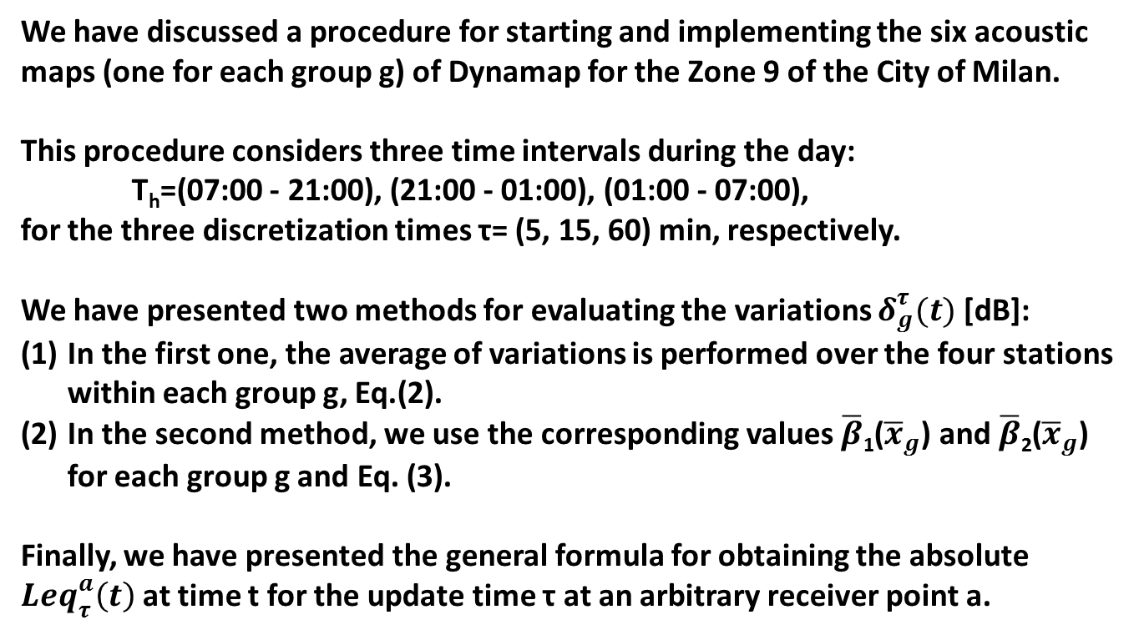
8. CONCLUSIONS
We have discussed a procedure for starting and implementing the six acoustic maps (one for each group g) of Dynamap for the Zone 9 of the City of Milan.
This procedure considers three time intervals during the day:
T_{h}=(07:00 - 21:00), (21:00 - 01:00), (01:00 - 07:00),
for the three discretization times τ= (5, 15, 60) min, respectively.
We have presented two methods for evaluating the variations $δ_{g}^{τ}(t)$ [dB]:
In the first one, the average of variations is performed over the four stations within each group g, Eq.(2).
In the second method, we use the corresponding values $\overline{β}$₁(${\overline{x}}_{g}$) and $\overline{β}$₂(${\overline{x}}_{g}$) for each group g and Eq. (3).
Finally, we have presented the general formula for obtaining the absolute ${Leq}_{τ}^{a}\left(t\right)$ at time t for the update time τ at an arbitrary receiver point a.

Slide 17
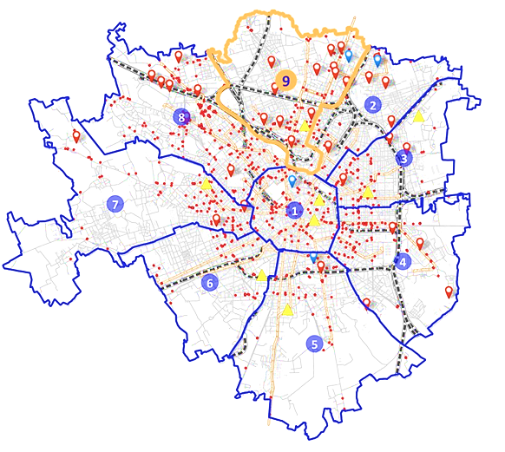
THANK YOU VERY MUCH
FOR YOUR ATTENTION

