Slide 1
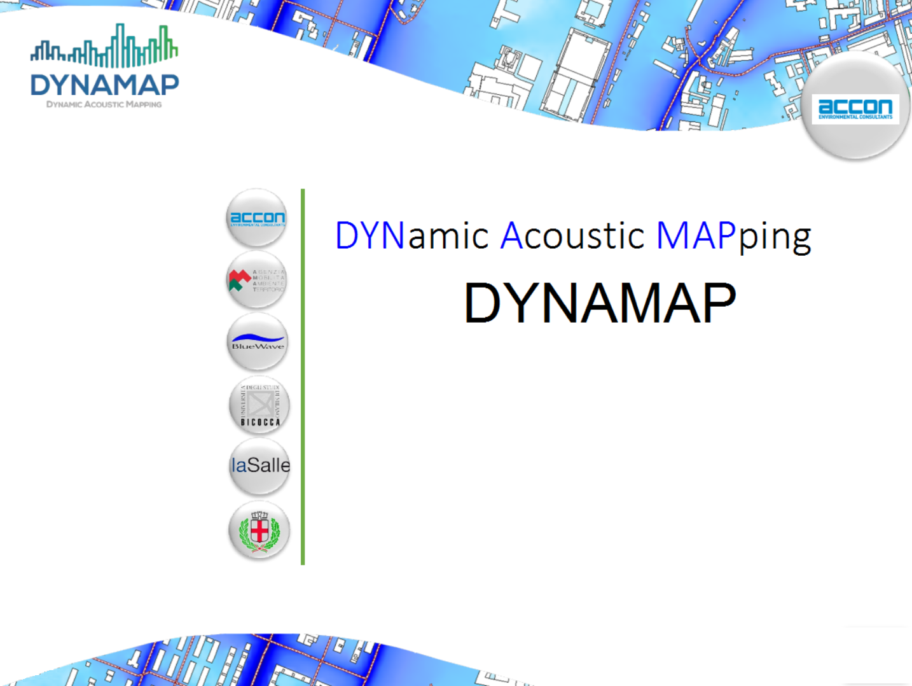

a powerful tool to improve environment
Andrea Cerniglia
ELPIT 2017 - Samara

Slide 2

Noise Maps: Why ?
European regulation request (every 5 years)
Action plans design purpose to reduce noise
where it excedes limits

Slide 3
Dynamic Noise Maps: What ?
A dynamic noise map is a noise map updated in real time according to measured noise, and published on a geoportal on the web

Slide 4
Dynamic Noise Maps: Why ?
Citizens partecipation in noise aspects
Possibility of ‘active’ noise management
Effective action plans design
Pleasantness of urban and country side sites
European regulation requests

Slide 5
Dynamic Noise Maps: Why ?
Citizens partecipation in noise aspects
Possibility of ‘active’ noise management
Effective action plans design
Pleasantness of urban and country side sites
European regulation requests

Slide 6
Dynamic Noise Maps: Why ?
Citizens partecipation because of real-time
communication to citizens and management of
their complaints about noise pollution

Slide 7
Dynamic Noise Maps: Why ?
Citizens partecipation in noise aspects
Possibility of ‘active’ noise management
Effective action plans design
Pleasantness of urban and country side sites
European regulation requests

Slide 8
Dynamic Noise Maps: Why ?
Possibility of ‘active’ noise management because
thanks to real-time measurements is possible
to drive variable message road signs
(i.e. speed limits)

Slide 9
Dynamic Noise Maps: Why ?
Citizens partecipation in noise aspects
Possibility of active noise management
Effective action plans design
Pleasantness of urban and country side sites
European regulation requests

Slide 10
Dynamic Noise Maps: Why ?
Effective action plans design because the
results are based on actual situation and not
just on some simulation

Slide 11
Dynamic Noise Maps: Why ?
Citizens partecipation in noise aspects
Possibility of ‘active’ noise management
Effective action plans design
Pleasantness of urban and country side sites
European regulation requests

Slide 12
Dynamic Noise Maps: Why ?
Pleasantness of urban and country side sites
because involved people and effective action
plans make the environment more smart and
pleasent

Slide 13
Dynamic Noise Maps: How ?

Slide 14
Scale and sum
Main idea of the system is to scale a set of pre-computed noise maps according acquired noise data, and sum them together in order to obtain the map of the whole area.
Precomputed map can be obtained with every
software (SoundPLAN, CadnaA, IMMI, Lima, etc)

Slide 15
Scale and sum
To scale the precomputed map is necessary that each measuring point is related with a single source

Slide 16
Scale and sum
Then the scaled map can be computed by adding (arithmetic) a value equal to the difference between the simulated and the measured level in the measuring point

Slide 17
2 Pilot areas
Part of the City of Milan
Ring Road around the city of Rome

Slide 18
Pilot areas
For the city a Milan, roads were divided in
six groups, each one with similar traffic
characteristics
For the Ring around Rome, there are 19
arches of road (each one beteween two
intersections)

Slide 19
Pilot areas
So in Milan there are 6 base maps to be scaled, whereas in Rome the number of base maps are 19.

Slide 20
Pilot areas
In Rome also weather conditions are taken into account, so there are 6 possible different propagation schemas according to weather conditions (homogeneus, favorable, favorable north, favorable est, favorable south, favorable west) and thus the number of base maps should be multiplied by 6

Slide 21
Pilot areas
Moreover in Rome also traffic conditions changes between working days and week-end, so the total number of base maps for Rome shoud be doubled.
Then, for Rome, there are 19 x 6 x 2 = 228 base maps

Slide 22
Pilot areas
Both Milan and Rome maps have about 300,000 points, so the number of operations to be performed for the sum and scale process is quite high.

Slide 23
Milan pilot area
The scaling and sum of 6 maps with 300,000 points each, in Milan involves:
1,800,000 products (6 x 300,000)
300,000 sums
300,000 products (again)
300,000 log₁₀

Slide 24
Rome pilot area
The scaling and sum of 6 maps with 300,000 points each, in Rome involves:
5,700,000 products (19 x 300,000)
300,000 sums
300,000 products (again)
300,000 log₁₀

Slide 25
Pilot areas
In order to reduce calculation time, some optimized algorithms were purposely developed and all the process, inculding publication on a geoportal, can be performed in less than 30 seconds.

Slide 26
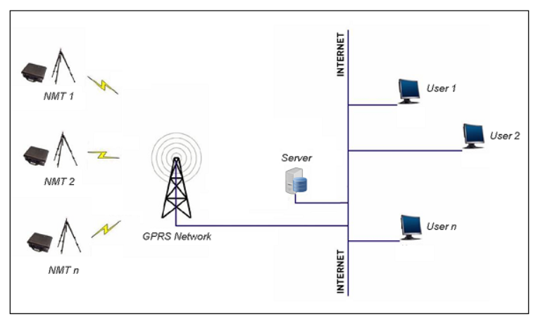
Measuring

Slide 27
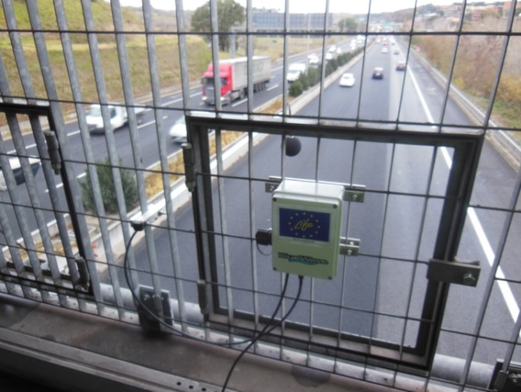
Measuring
In order to reduce costs, a special sound level meter was purposely developed.
The sound level meter
performs 1/3 octave
spectrum per sec and
is able to recognise
anomalous events on
time-freq behaviour and internal database

Slide 28
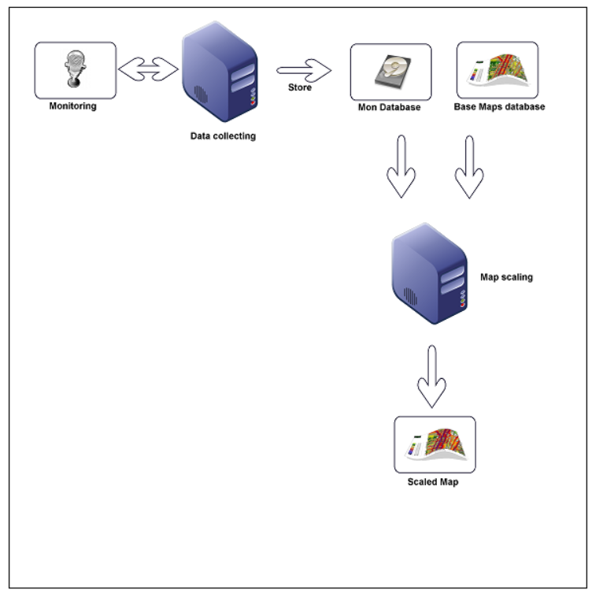
Block diagram

Slide 29
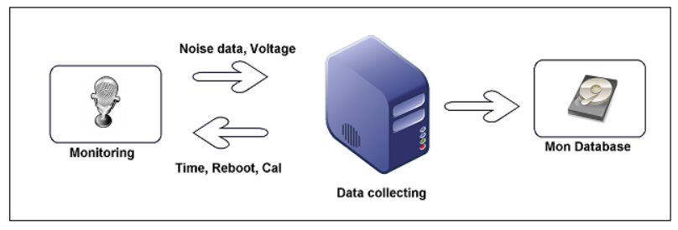
Data transmission
Communication between monitoring stations and data collecting unit is not limited to the transmission of the acquired data, but it is, in fact, a two-way communication

Slide 30
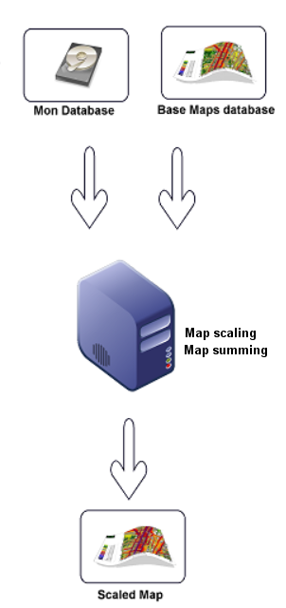
As already stated, the scale and sum process of basic maps involve a big number of operation, so there are two separate servers, one for Milan and the other one for Rome. The servers, only for sum and scale, have SSD HDD for fastest operations.

Slide 31
Calculation machines
Both calculation servers have Followinfg configuration:
LINUX
Apache 2
MySQL database
PHP scripting language
Pyton for scriptin language
Postgres/PostGIS geographical database
Geoserver as geoportal

Slide 32
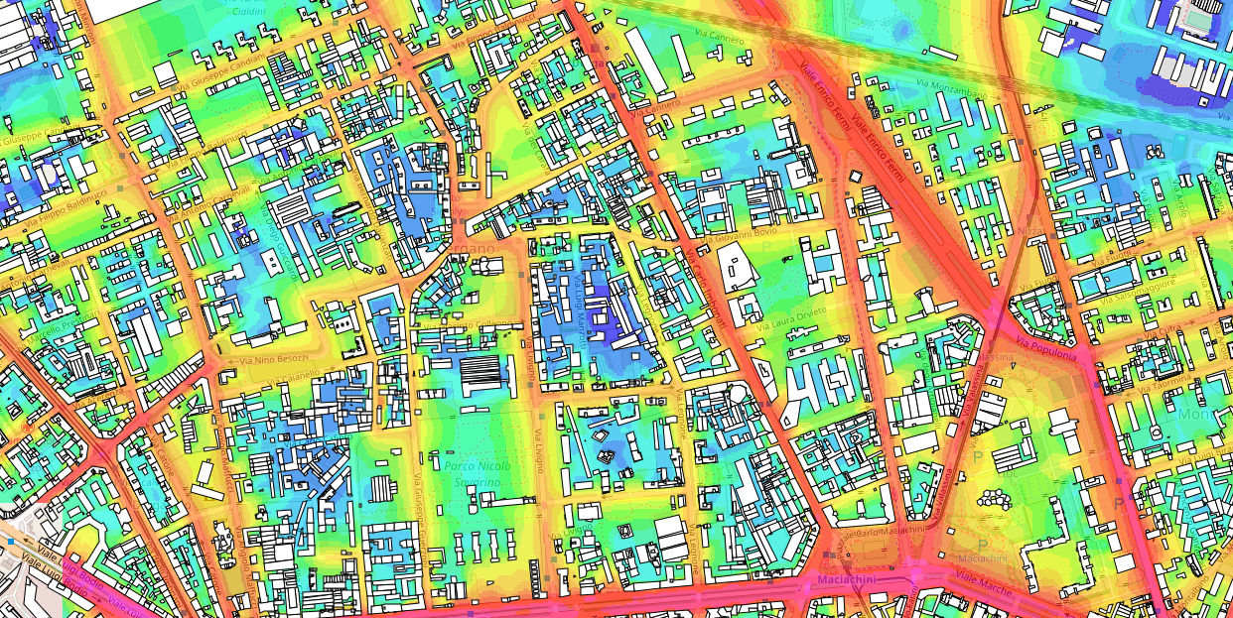
Milan map

Slide 33
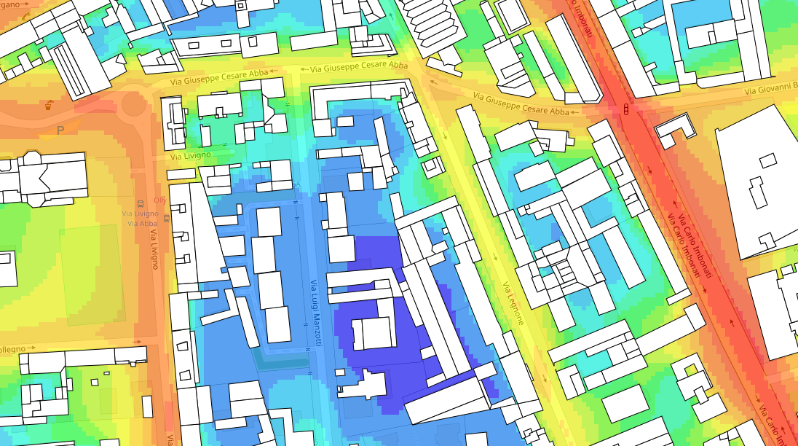
Milan map (zoomed in)

Slide 34
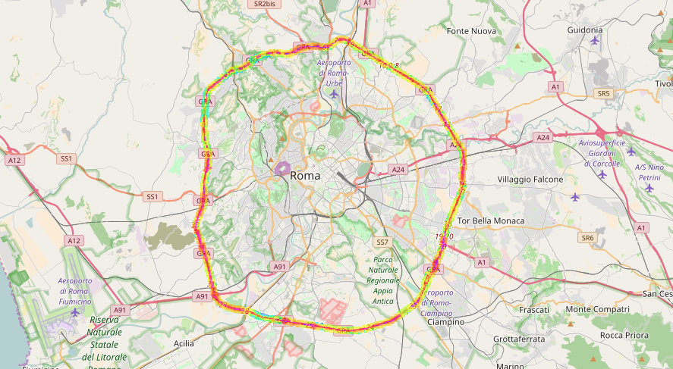
Rome map

Slide 35
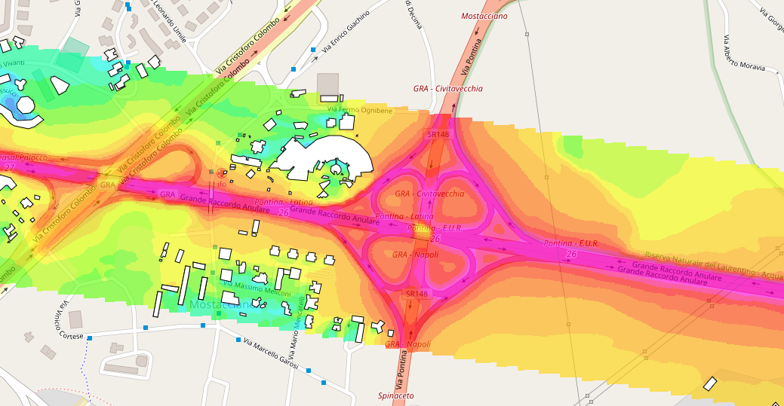
Rome map (zoomed in)

Slide 36
Thanks for your attention
andrea.cerniglia@accon.it

