Slide 1

THE LIFE DYNAMAP PROJECT
M.Grampella, P.Bellucci, P.Coppi
Milan Municipality
ANAS S.p.A. - Research Centre, Rome (Italy)
AMAT Milan Environmental Agency

Slide 2
PROJECT OBJECTIVES
The main objective is to ease and streamline the noise mapping process through the development of a low cost sensors system able to automatically update the noise maps in real time.
As a secondary objective, the project aims at demonstrating that dynamic mapping can be also applied to monitor and report the information related to other environmental parameters, such as those related to air quality, meteorological conditions, traffic, etc.
Finally, the Dynamap project aims also at developing a user-friendly software application to facilitate public information and communication.

Slide 3




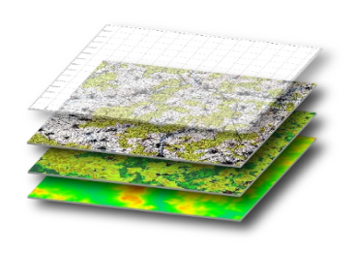
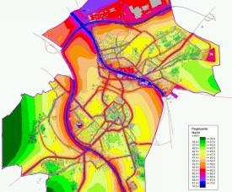
THE DYNAMAP SYSTEM
  Wireless noise sensors
  Data collection. Data sent from the sensors are analysed, processed and stored on a server
The processed signals are used to scale the basic noise maps .
Pre-calculated spatial noise map of Source 1
+
Sound level of source 1
+
Pre-calculated spatial noise map of Source n
+
Sound level of source n

Slide 4
MILAN MUNICIPALITY and AMAT
Milan Municipality is responsible for DYNAMAP dissemination and communication actions. It’s also involved in other project task related to the acquisition and the installation of monitoring system in Urban Pilot Area.
AMAT is the Milan Environmental Agency. It provides technical support to Milan Administration and it’s also partner in DYNAMAP project.

Slide 5
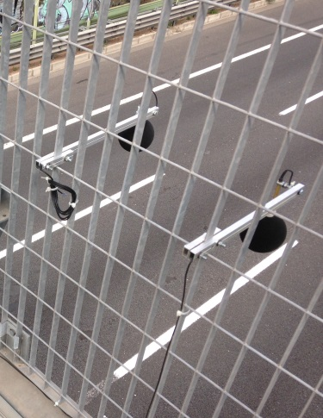
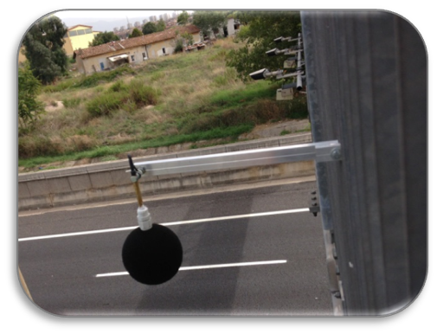
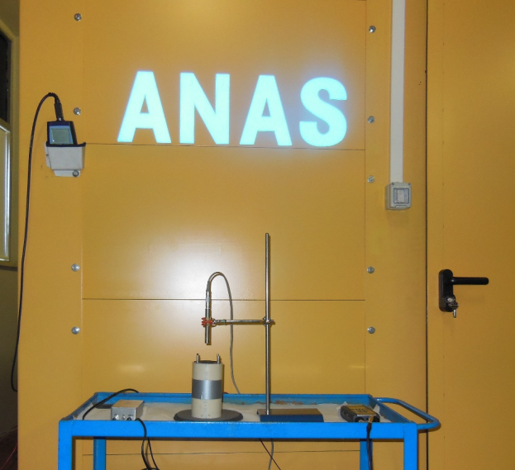
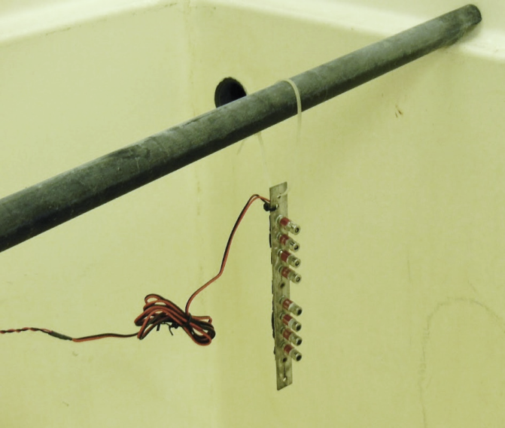
PROGRESS OF THE PROJECT
Development of the low cost monitoring devices
High computation capacity sensors
Low computation capacity sensors
Durability test at ANAS Road Research Centre

Slide 6
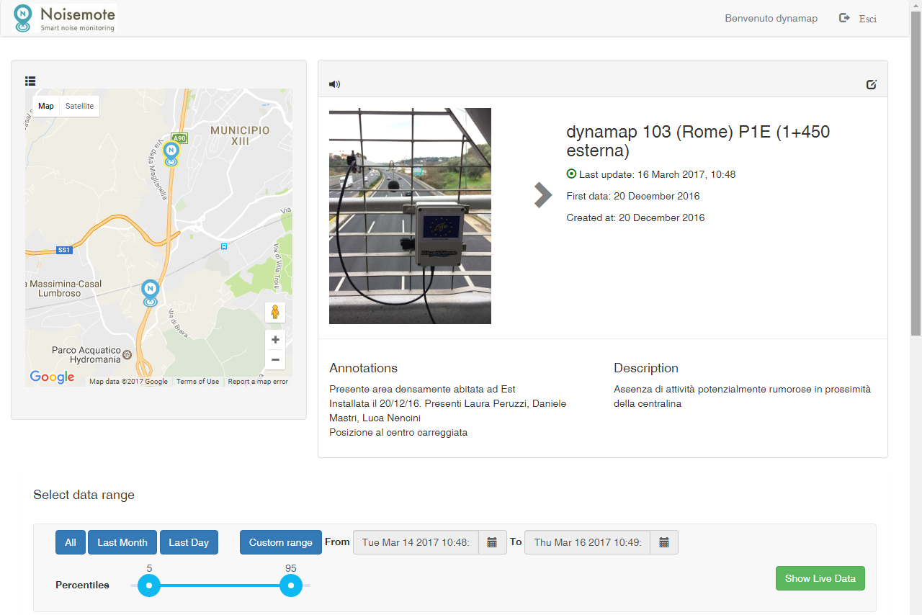
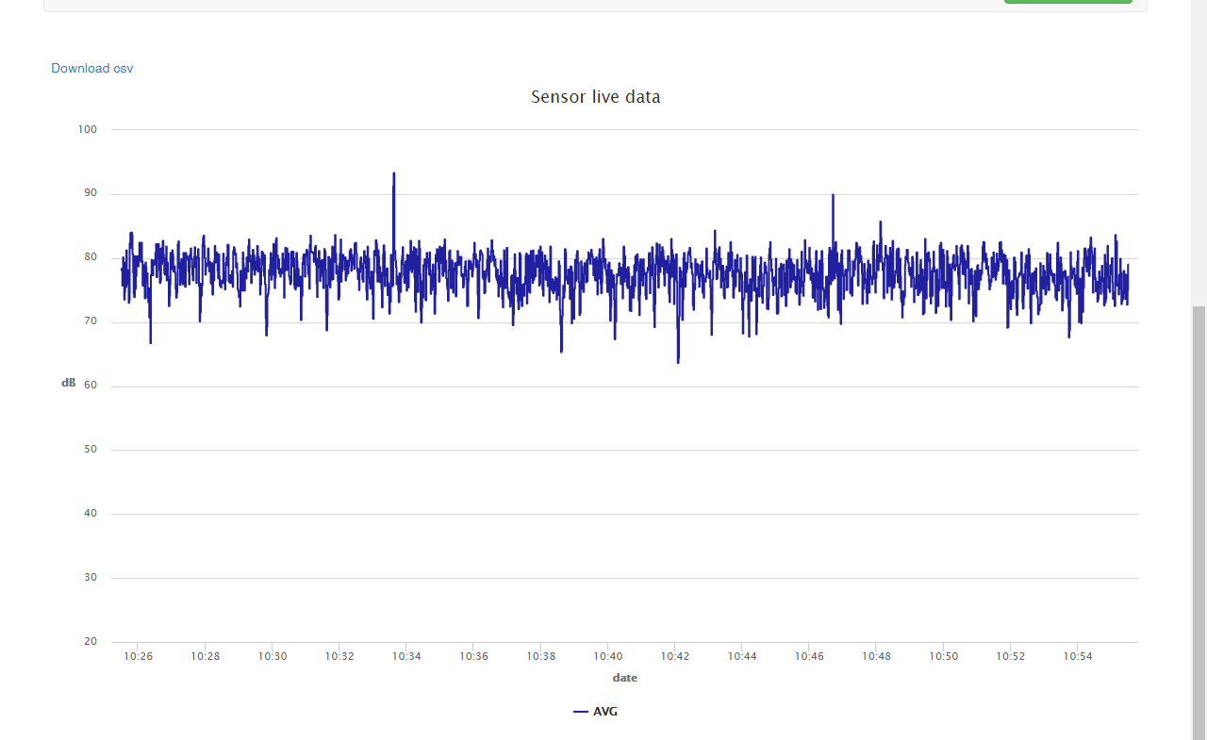
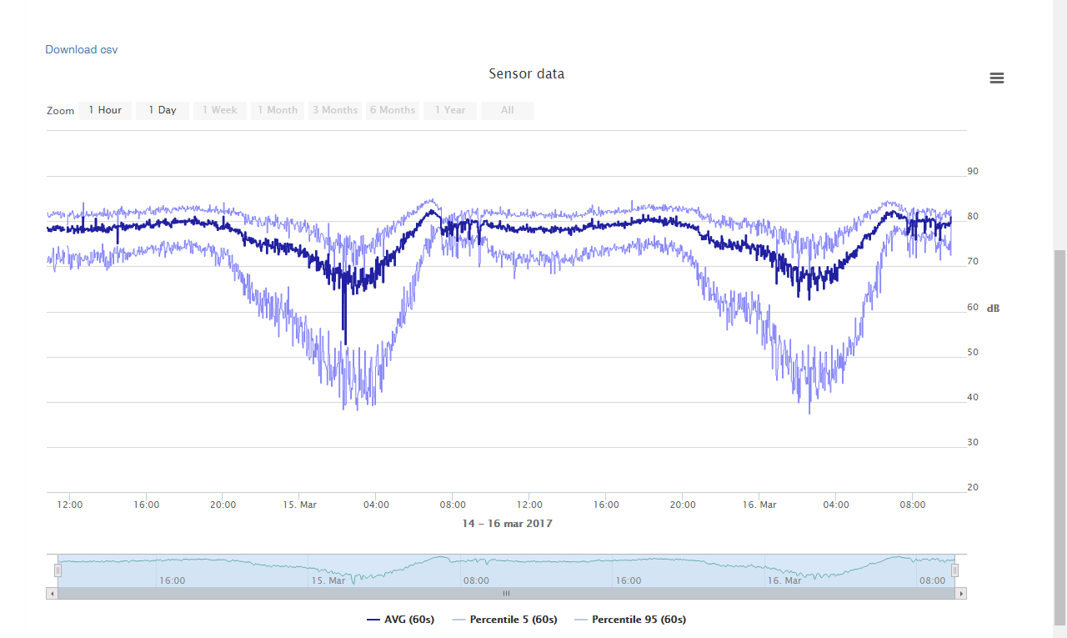

Slide 7
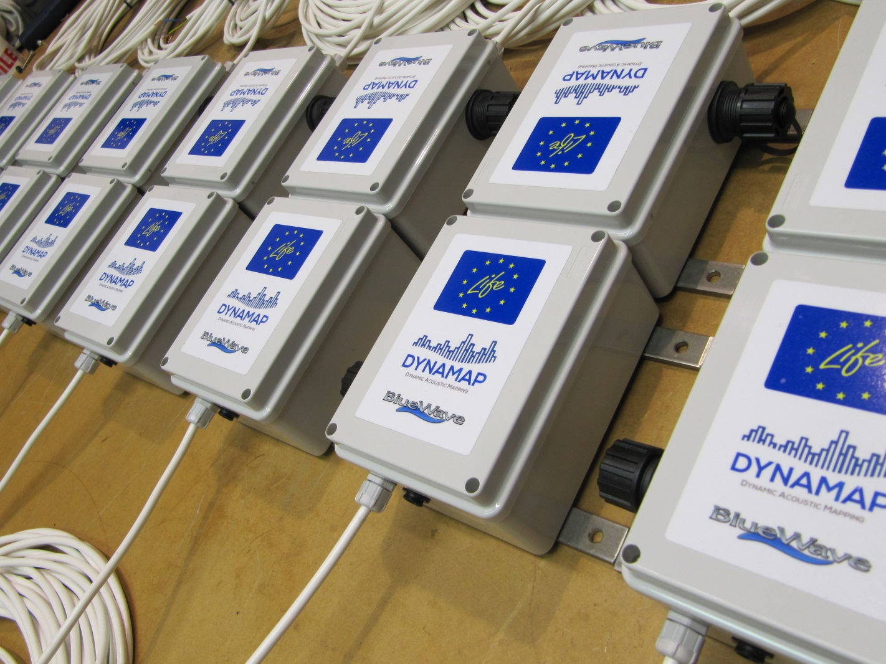
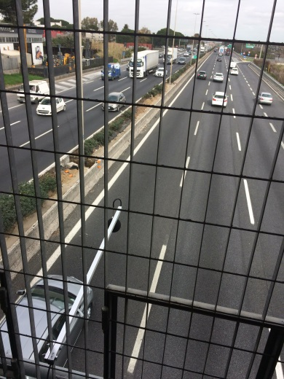
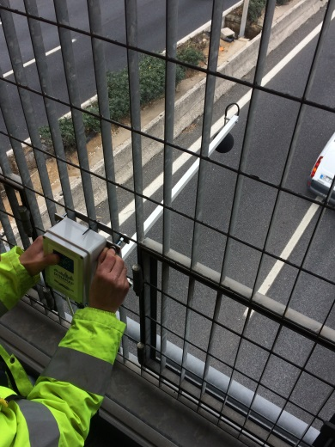
High Computation Capacity Devices

Slide 8
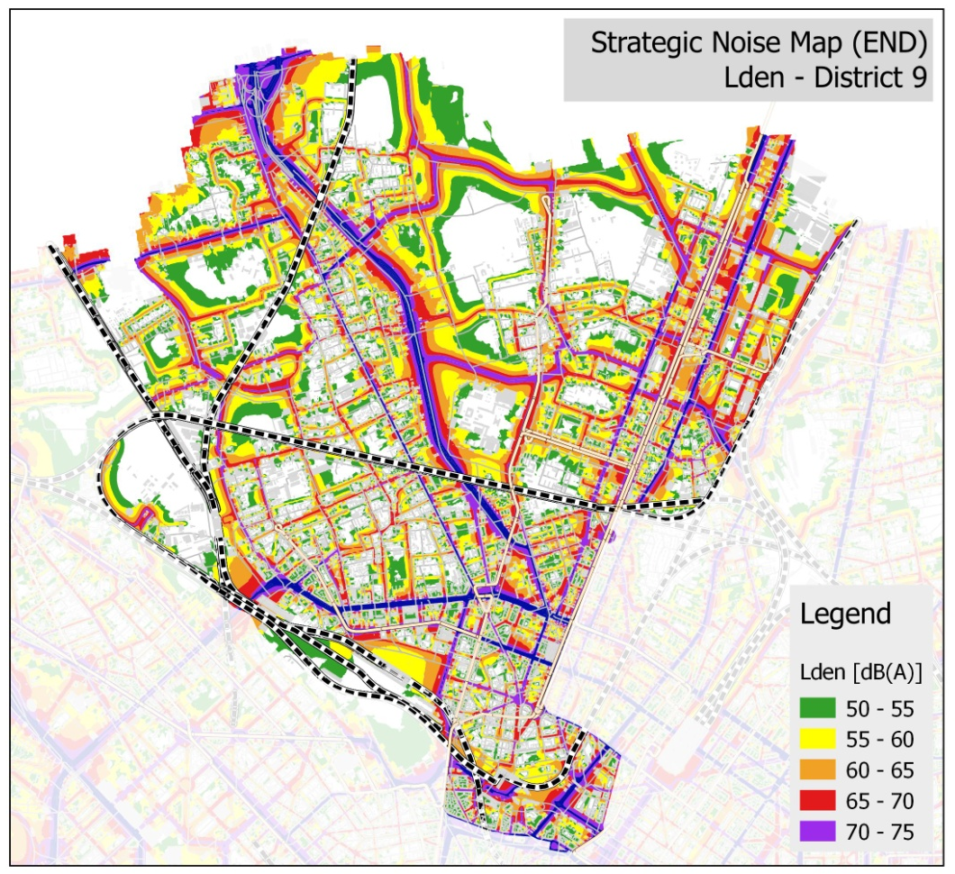
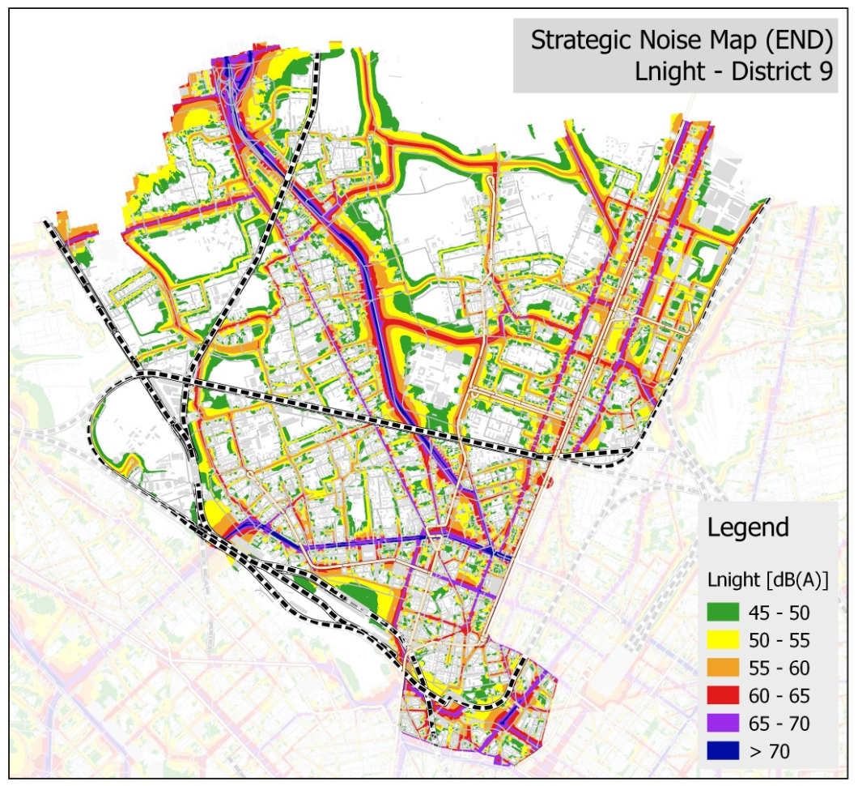
PILOT AREA LOCATION FOR URBAN CONTEXT (MILAN)
- District 9 -

Slide 9
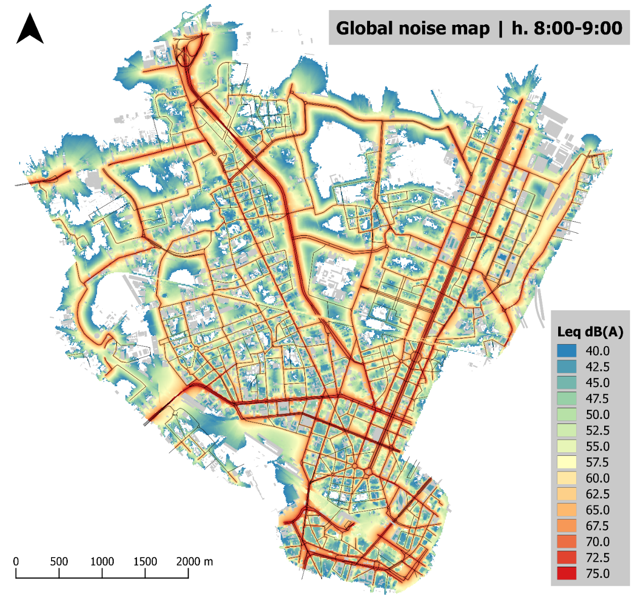

Slide 10
Task B5.2 – SYSTEM ACQUISITION AND INSTALLATION
Task leader: AMAT
Task participants: Milan Municipality, Blue Wave, Accon
The objective of this task is the acquisition and the installation of twenty four noise monitoring terminal (NMT). Each NMT contains one high capacity sensors. This action includes the following tasks:
the acquisition of the NMT
the achievement of the specific authorizations for system installation
the selection of the company which will physically install the devices
the installation of the devices

Slide 11
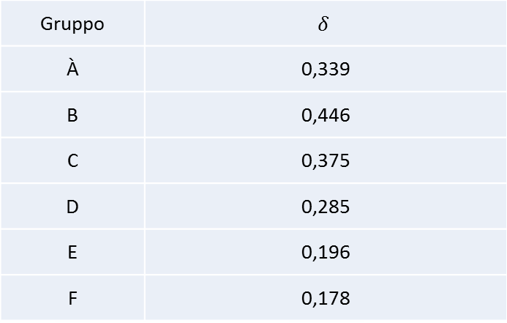
SITE SELECTION CRITERIA FOR MILAN PILOT AREA
Preliminary selection based on a statistical approach;
GIS analysis;
Geographical distribution;
Gruppo | $$δ$$
À | 0,339
B | 0,446
C | 0,375
D | 0,285
E | 0,196
F | 0,178

Slide 12
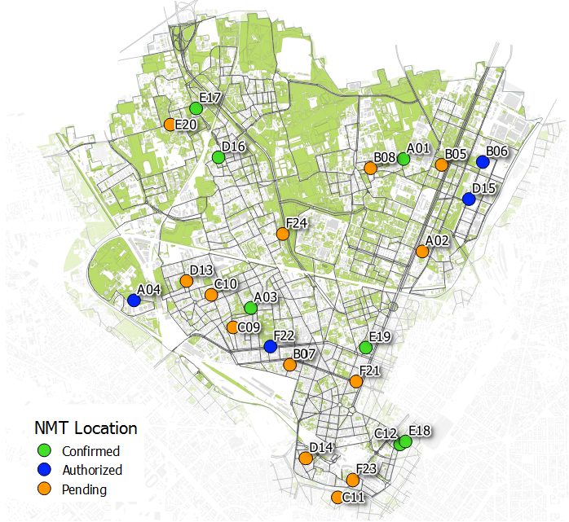
NMT locations

Slide 13
Achievement of specific authorizations for NMT installation
7 confirmed locations, ready for NMT installation
4 authorized locations (visit is planned for next week)
13 pending locations (including 9 buildings owned by Milan Municipality )

Slide 14
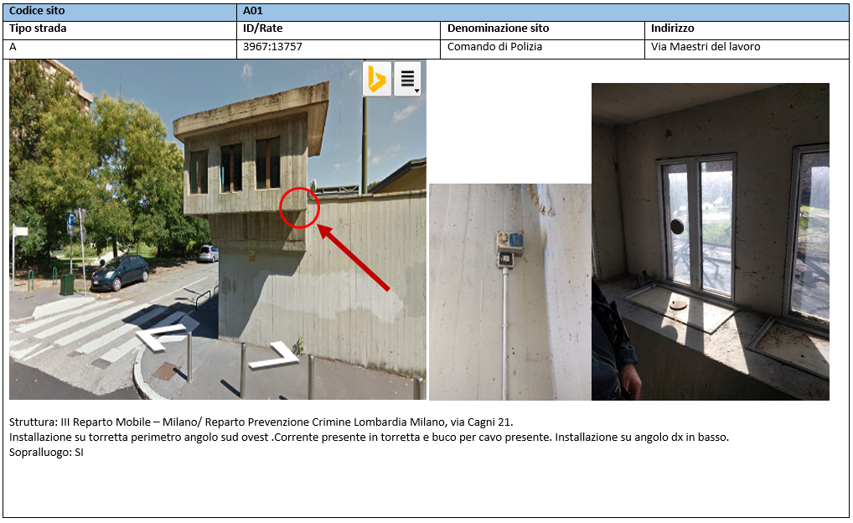
Noise monitoring terminal installation form (example 1)

Slide 15
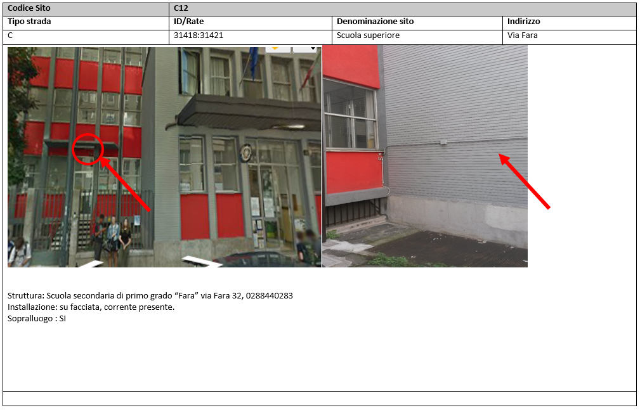
Noise monitoring terminal installation form (example 3)

Slide 16
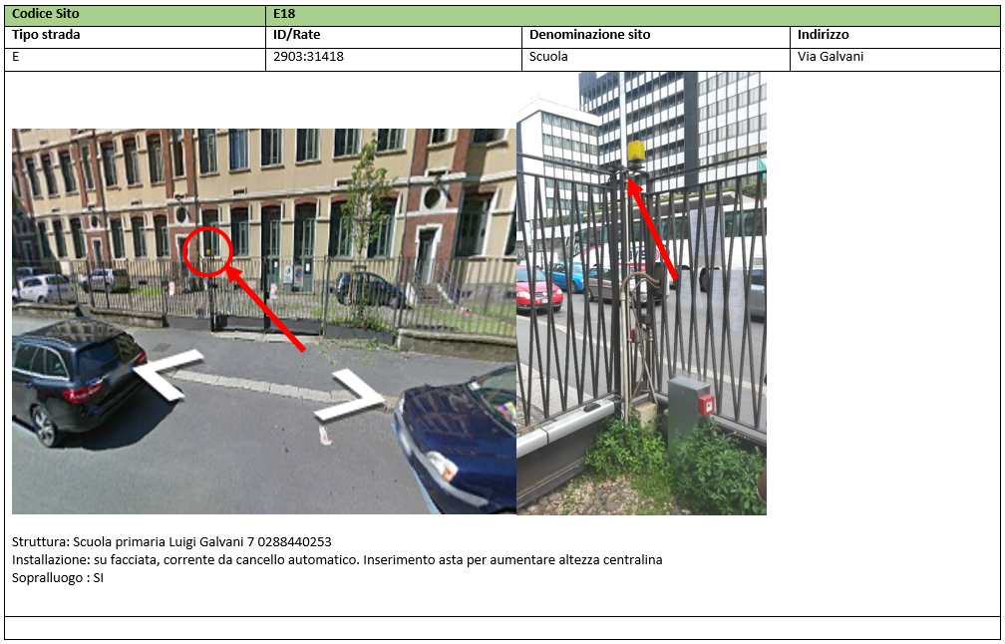
Noise monitoring terminal installation form (example 4)

Slide 17

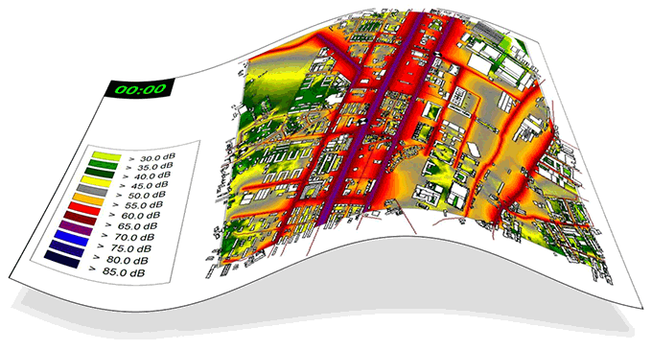
www.life-dynamap.eu

